Slide 1
Cross Platform Mobile C#, Mvvm and DataBinding
WP7
Android
iPhone
iPad
Win 8

Slide 2

@slodge

Slide 3

http://bit.ly/mvvmcross

Slide 4
Coming up…
C# Cross Platform
An Mvvm Introduction
Some Code: TwitterSearch
Some Extras
Q&A

Slide 5
Mobile C#

Slide 6
Why C#?
You already have:
skills
tools
code
“low level”
compiles
testable
quick
Enables native look and feel on all platforms
Generics, Linq, Async and the future…

Slide 7
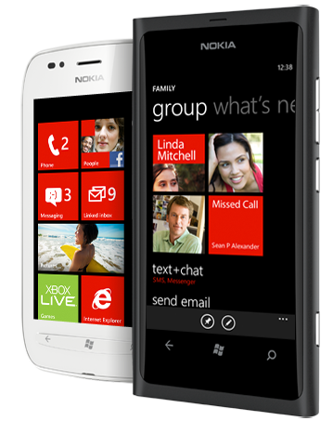

What you need – WP7:
A Windows 7 PC
Free Tools or better!
AppHub account $99
A phone sometimes helps…

Slide 8
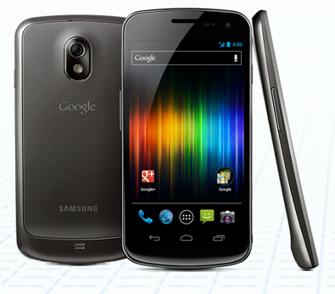
What you need - Android:
Windows PC or a Mac
Free Tools
Play account $25
A phone really helps…
Mono 4 Android $400

Slide 9
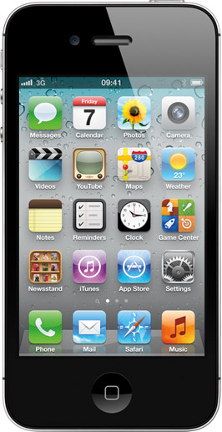
What you need - iOS:
An Intel-based Mac
Account-Linked Tools
iOS Account $99
A phone often helps…
MonoTouch - $400

Slide 10


Getting Started Links…

Slide 11
MVVM

Slide 12
Mvvm Basics
View
ViewModel
Model
View
ViewModel
Model
View
ViewModel
Model
get/set Properties
call Commands
Whatever C# you like!
notify changes
some messaging

Slide 13
MVVM Technical Details
Properties
INotifyPropertyChanged
INotifyCollectionChanged
Data Binding
IValueConverter
ICommand
UI Thread

Slide 14
Mvvm Benefits
The “normal” reasons:
Separation of concerns
Designability (Blendability)
Testability
The MvvmCross reason:
Cross platform code reuse

Slide 15
Mvvm Cross Platform
View
ViewModel
Model
View
ViewModel
Model
View
ViewModel
Model
get/set Properties
call Commands
Whatever C# you like!
notify changes
some messaging
Platform Specific
Shared

Slide 16



Some longer introductions…

Slide 17
Twitter Search

Slide 18
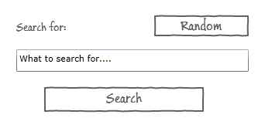

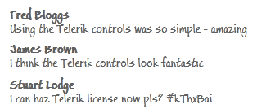
What we want to build…
Home Page:
Result Page:

Slide 19
The “core” code

Slide 20
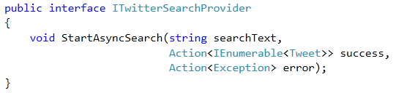
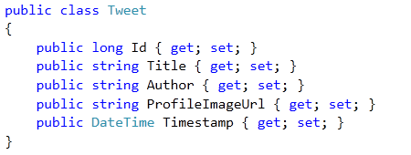
The Model and Service
STOLEN
From @ColinEberhardt

Slide 21
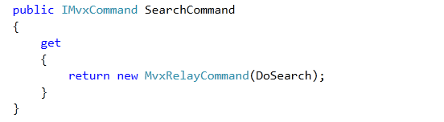
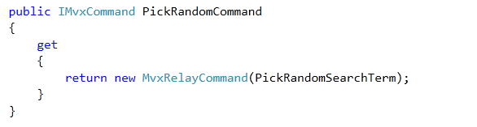
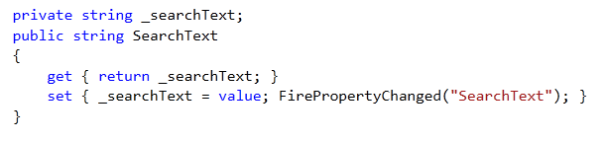
HomeViewModel

Slide 22
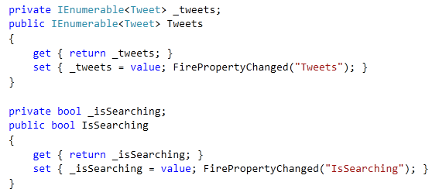
TwitterViewModel

Slide 23


Navigation
The HomeViewModel calls:
Which means the TwitterViewModel gets created with:

Slide 24
The clients

Slide 25
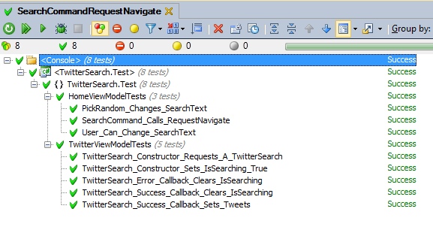
Some Unit Tests

Slide 26
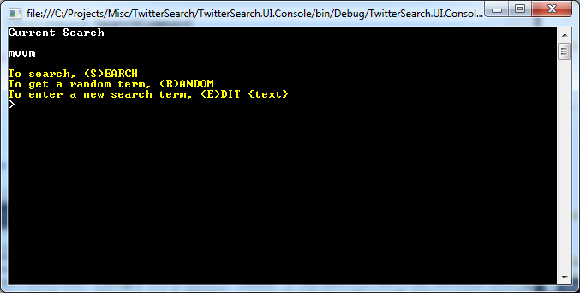
A Console App

Slide 27
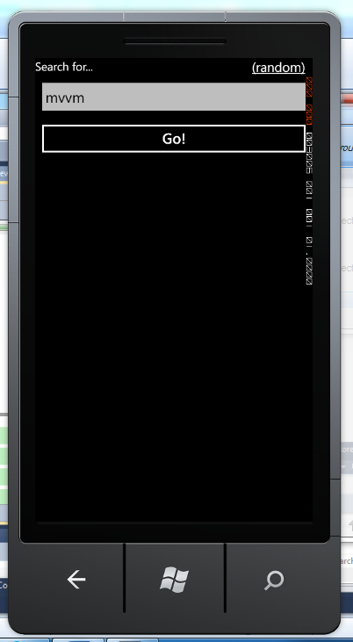
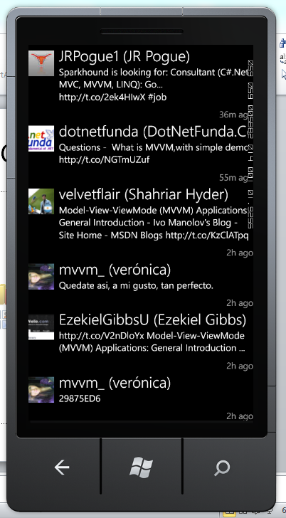
A WP7 App

Slide 28


An Android App

Slide 29
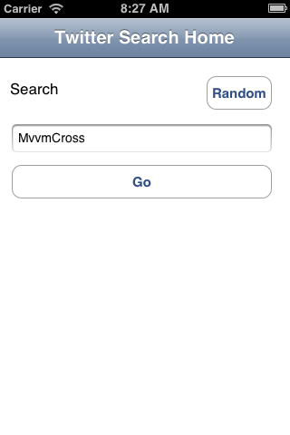

iPhone App

Slide 30

iPad App

Slide 31
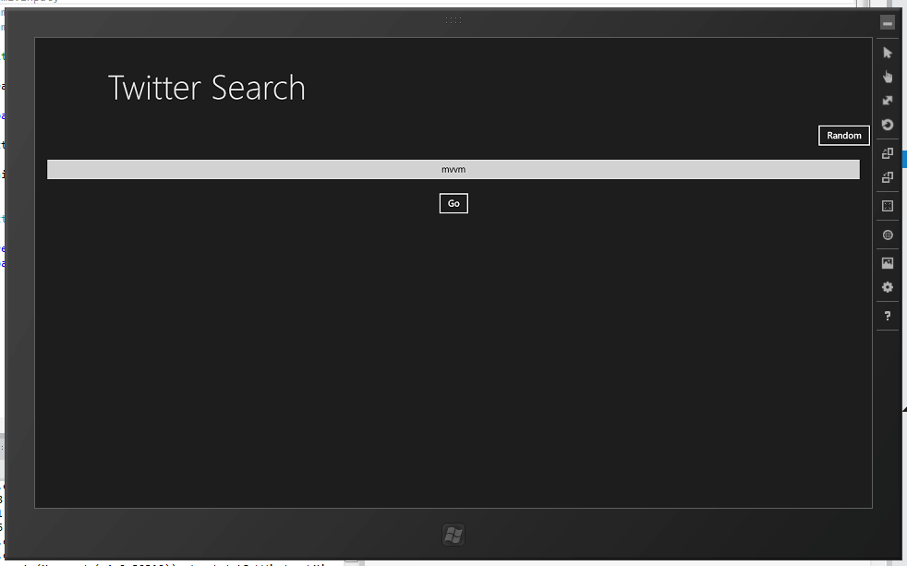

Windows 8 Metro App

Slide 32
Inside…

Slide 33
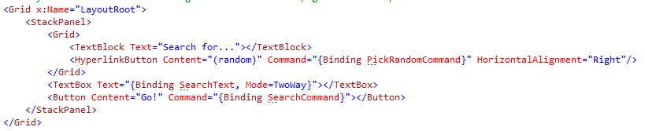
Inside WP7 App…
No C#, just XAML with {Binding}
Binding syntax includes:
{Binding Path, Converter=Converter, ConverterParameter=Parameter, Mode=Mode, FallbackValue=Fallback}

Slide 34
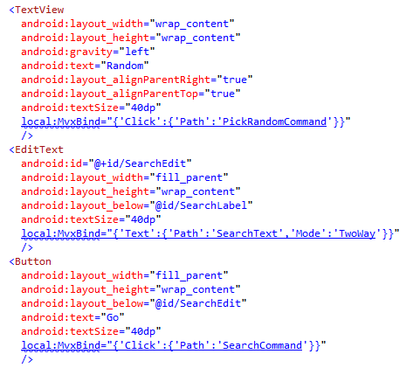
Inside Android App…
No C#, just xml with MvxBind attributes
MvxBind syntax is JSON based on XAML structure.

Slide 35
Binding – Xaml versus Mvx
WP7:
Text=“{Binding SearchText,Mode=TwoWay}”
Android:
local:MvxBind=“{‘Text’:
{‘Path’:’SearchText’,’Mode’:’TwoWay’}}”

Slide 36
Binding – Xaml versus Mvx
WP7:
Text=“{Binding Timestamp,Converter={StaticResource TimeAgo}}”
Android:
local:MvxBind=“{‘Text’:
{‘Path’:’Timestamp’,Converter’:’TimeAgo’}}”

Slide 37
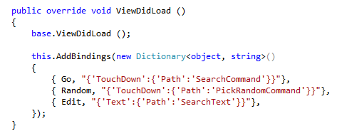
Inside iPhone App
UI is drawn in XML using Xcode
XIB is linked to C# classes using MonoTouch
Binding is declared in C# using JSON

Slide 38

Creating the XIB…

Slide 39

Inside iPad App
The iPad App is actually the iPhone App – “Universal”
But the UI is different – take advantage of the larger screen.
Achieved in code: IMvxTouchViewPresenter

Slide 40
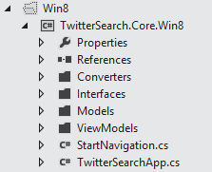
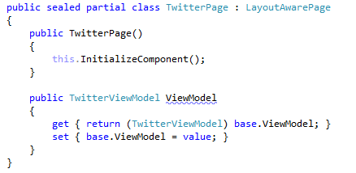
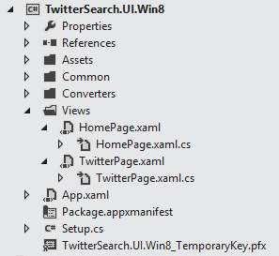
Inside Windows 8 Metro App…

Slide 41
Inside Windows 8 Metro App…
It’s like WP7….
No C#, just XAML with {Binding}
ValueConverters are used in Bindings
Lists are filled using ItemsSource
BUT: Navigation is achieved through code – not Xaml Uri’s

Slide 42

Inside Windows 8 Metro App
Warnings:
MvvmCross WinRT implementation is “first cut”
e.g. differences in ViewModel lifecycle
Under-the-hood Win8 implementation is native code – there are big differences.
differences in XAML
differences in .Net/C#
Everything is async.

Slide 43
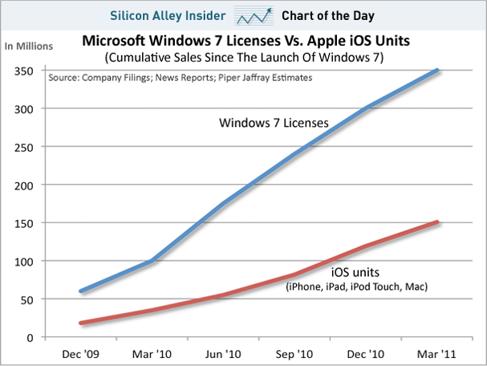
Inside Windows 8 Metro App…
Beyond the warnings – look at the numbers!

Slide 44
Recap

Slide 45
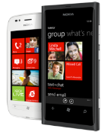
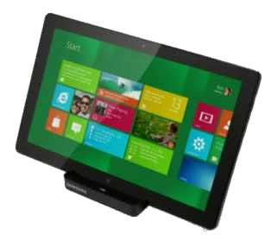

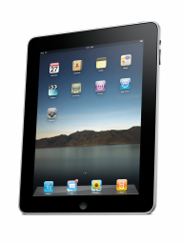

TwitterSearch recap…
Shared C# Core
ViewModels
Models
Services
Converters
Tests
UIs are “mostly XML/JSON”

Slide 46
Some Extras

Slide 47

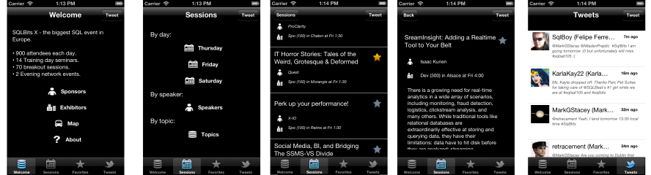
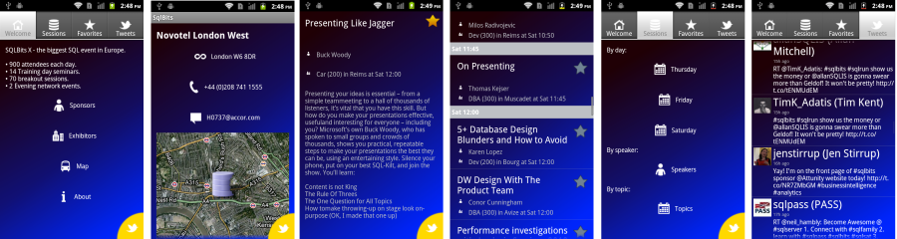

Slide 48



Panoramas, Pivots and Tabs
Tabbed navigation is another common metaphor across phones and across ipads too.
Generally speaking think of each “tab” as a sub-ViewModel.

Slide 49
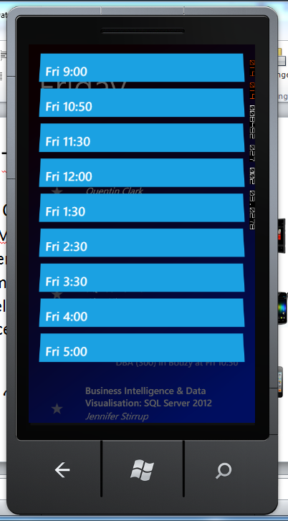
Jump Lists
Use grouped list on each viewmodel…
Each platform then works out its own format

Slide 50
Dependency Injection
Useful for testing
Essential for injecting platform specific services – e.g:
Camera capture
GPS services
NFC
MvvmCross wraps OpenNetCF DI – adds some extension methods:
RegisterServiceInstance<TService>(instance)
RegisterServiceType<TService, TServiceType>()
GetService<TService>()

Slide 51
Native Types
Sometimes #define is necessary…
Personally, I try to use interfaces and DI wherever possible.

Slide 52
i18n
Choices:
Each platform has their own localisation format available.
Xamarin are supporting .resx files…
MvvmCross provides a .json file mechanism
Or write your own

Slide 53
Blendability
Limited support available right now.
It’s relatively easy to integrate your own design time ViewModelLocator with design time data…

Slide 54
Problems?
WinRT – issues…
Xcode designer - OMG
iOS development and debugging is most painful
Some compiler differences – JIT
Multiple “core” project files annoying – and breaks refactoring
MvvmCross still changing

Slide 55
That’s all folks

Slide 56
That’s all folks…
Hopefully we covered:
C# Cross Platform
An Mvvm Introduction
Some Code: TwitterSearch
Some Extras
There might be time for:
Q&A

Slide 57
@slodge

Slide 58
http://bit.ly/mvvmcross

Slide 59

Alternatives: http://bit.ly/rrnLDT

